Slide 1
Retrieving Data Using the SQL SELECT Statement

Slide 3
Objectives
After completing this lesson, you should be able to do the following:
  List the capabilities of SQL SELECT statements
  Execute a basic SELECT statement
  Differentiate between SQL statements and SQL*Plus commands
Notes:
Objectives
To extract data from the database, you need to use the structured query language (SQL) SELECT statement. You may need to restrict the columns that are displayed. This lesson describes all the SQL statements that are needed to perform these actions. You may want to create SELECT statements that can be used more than once.
This lesson also covers the iSQL*Plus environment in which you execute SQL statements.

Slide 4
Objectives
After completing this lesson, you should be able to do the following:
  List the capabilities of SQL SELECT statements
  Execute a basic SELECT statement
  Differentiate between SQL statements and iSQL*Plus commands
Notes:
Objectives
To extract data from the database, you need to use the structured query language (SQL) SELECT statement. You may need to restrict the columns that are displayed. This lesson describes all the SQL statements that are needed to perform these actions. You may want to create SELECT statements that can be used more than once.
This lesson also covers the iSQL*Plus environment in which you execute SQL statements.

Slide 5
Capabilities of SQL SELECT Statements
Projection
Selection
Table 1
Table 1
Join
Table 1
Table 2
Notes:
Capabilities of SQL SELECT Statements
A SELECT statement retrieves information from the database. With a SELECT statement, you can use the following capabilities:
Projection: Choose the columns in a table that are returned by a query. Choose as few or as many of the columns as needed
Selection: Choose the rows in a table that are returned by a query. Various criteria can be used to restrict the rows that are retrieved.
Joining: Bring together data that is stored in different tables by specifying the link between them. SQL joins are covered in more detail in a later lesson.

Slide 6
Basic SELECT Statement
SELECT *|{[DISTINCT] column|expression [alias],...}
FROM table;
  SELECT identifies the columns to be displayed
  FROM identifies the table containing those columns
Notes:
Basic SELECT Statement
In its simplest form, a SELECT statement must include the following:
A SELECT clause, which specifies the columns to be displayed
A FROM clause, which identifies the table containing the columns that are listed in the SELECT clause
In the syntax:
SELECT is a list of one or more columns
* selects all columns
DISTINCT suppresses duplicates
column|expression selects the named column or the expression
alias gives selected columns different headings
FROM table specifies the table containing the columns
Note: Throughout this course, the words keyword, clause, and statement are used as follows:
A keyword refers to an individual SQL element.
For example, SELECT and FROM are keywords.
A clause is a part of a SQL statement.
For example, SELECT employee_id, last_name, ... is a clause.
A statement is a combination of two or more clauses.
For example, SELECT * FROM employees is a SQL statement.

Slide 7
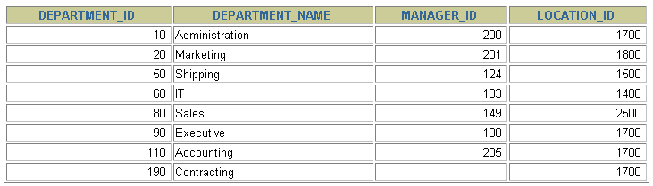
Selecting All Columns
SELECT *
FROM departments;
Notes:
Selecting All Columns of All Rows
You can display all columns of data in a table by following the SELECT keyword with an asterisk (*). In the example in the slide, the department table contains four columns: DEPARTMENT_ID, DEPARTMENT_NAME, MANAGER_ID, and LOCATION_ID. The table contains seven rows, one for each department.
You can also display all columns in the table by listing all the columns after the SELECT keyword. For example, the following SQL statement (like the example in the slide) displays all columns and all rows of the DEPARTMENTS table:
SELECT department_id, department_name, manager_id, location_id
FROM departments;

Slide 8
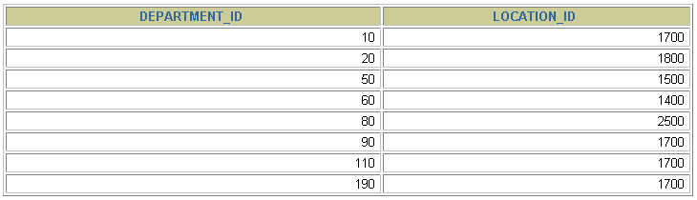
Selecting Specific Columns
SELECT department_id, location_id
FROM departments;
Notes:
Selecting Specific Columns of All Rows
You can use the SELECT statement to display specific columns of the table by specifying the column names, separated by commas. The example in the slide displays all the department numbers and location numbers from the DEPARTMENTS table.
In the SELECT clause, specify the columns that you want, in the order in which you want them to appear in the output. For example, to display location before department number going from left to right, you use the following statement:
SELECT location_id, department_id
FROM departments;

Slide 9
Writing SQL Statements
  SQL statements are not case-sensitive.
  SQL statements can be on one or more lines.
  Keywords cannot be abbreviated or split
  across lines.
  Clauses are usually placed on separate lines.
  Indents are used to enhance readability.
  In SQL*plus, you are required to end each SQL statement with a semicolon (;).
Notes:
Writing SQL Statements
Using the following simple rules and guidelines, you can construct valid statements that are both easy to read and easy to edit:
SQL statements are not case-sensitive (unless indicated).
SQL statements can be entered on one or many lines.
• Keywords cannot be split across lines or abbreviated.
Clauses are usually placed on separate lines for readability and ease of editing.
• Indents should be used to make code more readable.
Keywords typically are entered in uppercase; all other words, such as table names and columns, are entered in lowercase.
Executing SQL Statements
Using iSQL*Plus, click the Execute button to run the command or commands in the editing window.
Using SQL*Plus, terminate the SQL statement with a semicolon and then press the Enter key to run the command.

Slide 10
Writing SQL Statements
  SQL statements are not case-sensitive.
  SQL statements can be on one or more lines.
  Keywords cannot be abbreviated or split
  across lines.
  Clauses are usually placed on separate lines.
  Indents are used to enhance readability.
  In iSQL*Plus, SQL statements can optionally be terminated by a semicolon (;). Semicolons are required if you execute multiple SQL statements.
  In SQL*plus, you are required to end each SQL statement with a semicolon (;).
Notes:
Writing SQL Statements
Using the following simple rules and guidelines, you can construct valid statements that are both easy to read and easy to edit:
SQL statements are not case-sensitive (unless indicated).
SQL statements can be entered on one or many lines.
• Keywords cannot be split across lines or abbreviated.
Clauses are usually placed on separate lines for readability and ease of editing.
• Indents should be used to make code more readable.
Keywords typically are entered in uppercase; all other words, such as table names and columns, are entered in lowercase.
Executing SQL Statements
Using iSQL*Plus, click the Execute button to run the command or commands in the editing window.
Using SQL*Plus, terminate the SQL statement with a semicolon and then press the Enter key to run the command.

Slide 11
Column Heading Defaults
  SQL*Plus:
    Character and Date column headings are left- aligned
    Number column headings are right-aligned
    Default heading display: Uppercase
Notes:
Column Heading Defaults
In iSQL*Plus, column headings are displayed in uppercase and centered.
SELECT last_name, hire_date, salary
FROM employees;
You can override the column heading display with an alias. Column aliases are covered later in this lesson.
…

Slide 12
Column Heading Defaults
  iSQL*Plus:
    Default heading alignment: Center
    Default heading display: Uppercase
  SQL*Plus:
    Character and Date column headings are left- aligned
    Number column headings are right-aligned
    Default heading display: Uppercase
Notes:
Column Heading Defaults
In iSQL*Plus, column headings are displayed in uppercase and centered.
SELECT last_name, hire_date, salary
FROM employees;
You can override the column heading display with an alias. Column aliases are covered later in this lesson.
…

Slide 13
Arithmetic Expressions
Create expressions with number and date data by using arithmetic operators.
Operator | Description
+ | Add
- | Subtract
* | Multiply
/ | Divide
Notes:
Arithmetic Expressions
You may need to modify the way in which data is displayed, or you may want to perform calculations or look at what-if scenarios. These are all possible using arithmetic expressions. An arithmetic expression can contain column names, constant numeric values, and the arithmetic operators.
Arithmetic Operators
The slide lists the arithmetic operators that are available in SQL. You can use arithmetic operators in any clause of a SQL statement (except the FROM clause).
Note: With DATE and TIMESTAMP data types, you can use the addition and subtraction operators only.

Slide 14
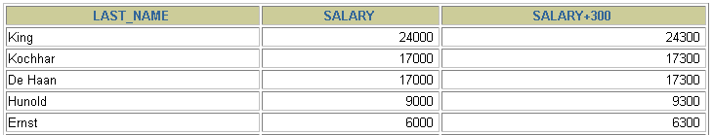
Using Arithmetic Operators
SELECT last_name, salary, salary + 300
FROM employees;
…
Notes:
Using Arithmetic Operators
The example in the slide uses the addition operator to calculate a salary increase of $300 for all employees. The slide also displays a SALARY+300 column in the output.
Note that the resultant calculated column SALARY+300 is not a new column in the EMPLOYEES table; it is for display only. By default, the name of a new column comes from the calculation that generated it—in this case, salary+300.
Note: The Oracle server ignores blank spaces before and after the arithmetic operator.
Operator Precedence
If an arithmetic expression contains more than one operator, multiplication and division are evaluated first. If operators in an expression are of the same priority, then evaluation is done from left to right.
You can use parentheses to force the expression that is enclosed by parentheses to be evaluated first.
Rules of Precedence:
Multiplication and division occur before addition and subtraction.
Operators of the same priority are evaluated from left to right.
Parentheses are used to override the default precedence or to clarify the statement.

Slide 15


Operator Precedence
SELECT last_name, salary, 12*salary+100
FROM employees;
1
…
SELECT last_name, salary, 12*(salary+100)
FROM employees;
2
…
Notes:
Operator Precedence (continued)
The first example in the slide displays the last name, salary, and annual compensation of employees. It calculates the annual compensation by multiplying the monthly salary by 12, plus a one-time bonus of $100. Notice that multiplication is performed before addition.
Note: Use parentheses to reinforce the standard order of precedence and to improve clarity. For example, the expression in the slide can be written as (12*salary)+100 with no change in the result.
Using Parentheses
You can override the rules of precedence by using parentheses to specify the desired order in which operators are to be executed.
The second example in the slide displays the last name, salary, and annual compensation of employees. It calculates the annual compensation as follows: adding a monthly bonus of $100 to the monthly salary, and then multiplying that subtotal by 12. Because of the parentheses, addition takes priority over multiplication.

Slide 16
Defining a Null Value
  A null is a value that is unavailable, unassigned, unknown, or inapplicable.
  A null is not the same as a zero or a blank space.
SELECT last_name, job_id, salary, commission_pct
FROM employees;
…
…
Notes:
Null Values
If a row lacks a data value for a particular column, that value is said to be null or to contain a null.
A null is a value that is unavailable, unassigned, unknown, or inapplicable. A null is not the same as a zero or a space. Zero is a number, and a space is a character.
Columns of any data type can contain nulls. However, some constraints (NOT NULL and PRIMARY KEY) prevent nulls from being used in the column.
In the COMMISSION_PCT column in the EMPLOYEES table, notice that only a sales manager or sales representative can earn a commission. Other employees are not entitled to earn commissions. A null represents that fact.

Slide 17
Null Values in Arithmetic Expressions
Arithmetic expressions containing a null value evaluate to null.
SELECT last_name, 12*salary*commission_pct
FROM employees;
…
…
Notes:
Null Values in Arithmetic Expressions
If any column value in an arithmetic expression is null, the result is null. For example, if you attempt to perform division by zero, you get an error. However, if you divide a number by null, the result is a null or unknown.
In the example in the slide, employee King does not get any commission. Because the COMMISSION_PCT column in the arithmetic expression is null, the result is null.
For more information, see “Basic Elements of SQL” in the SQL Reference.

Slide 18
Defining a Column Alias
A column alias:
  Renames a column heading
  Is useful with calculations
  Immediately follows the column name (There can also be the optional AS keyword between the column name and alias.)
  Requires double quotation marks if it contains spaces or special characters or if it is case-sensitive
Notes:
Column Aliases
When displaying the result of a query, iSQL*Plus normally uses the name of the selected column as the column heading. This heading may not be descriptive and hence may be difficult to understand. You can change a column heading by using a column alias.
Specify the alias after the column in the SELECT list using a space as a separator. By default, alias headings appear in uppercase. If the alias contains spaces or special characters (such as # or $), or if it is case-sensitive, enclose the alias in double quotation marks (" ").

Slide 19


Using Column Aliases
SELECT last_name AS name, commission_pct comm
FROM employees;
…
SELECT last_name "Name" , salary*12 "Annual Salary"
FROM employees;
…
Notes:
Column Aliases (continued)
The first example displays the names and the commission percentages of all the employees. Notice that the optional AS keyword has been used before the column alias name. The result of the query is the same whether the AS keyword is used or not. Also notice that the SQL statement has the column aliases, name and comm, in lowercase, whereas the result of the query displays the column headings in uppercase. As mentioned in a previous slide, column headings appear in uppercase by default.
The second example displays the last names and annual salaries of all the employees. Because Annual Salary contains a space, it has been enclosed in double quotation marks. Notice that the column heading in the output is exactly the same as the column alias.

Slide 20

Concatenation Operator
A concatenation operator:
  Links columns or character strings to other columns
  Is represented by two vertical bars (||)
  Creates a resultant column that is a character expression
SELECT last_name||job_id AS "Employees"
FROM employees;
…
Notes:
Concatenation Operator
You can link columns to other columns, arithmetic expressions, or constant values to create a character expression by using the concatenation operator (||). Columns on either side of the operator are combined to make a single output column.
In the example, LAST_NAME and JOB_ID are concatenated, and they are given the alias Employees. Notice that the employee last name and job code are combined to make a single output column.
The AS keyword before the alias name makes the SELECT clause easier to read.
Null Values with the Concatenation Operator
If you concatenate a null value with a character string, the result is a character string. LAST_NAME || NULL results in LAST_NAME.

Slide 21
Literal Character Strings
  A literal is a character, a number, or a date that is included in the SELECT statement.
  Date and character literal values must be enclosed by single quotation marks.
  Each character string is output once for each
  row returned.
Notes:
Literal Character Strings
A literal is a character, a number, or a date that is included in the SELECT list and that is not a column name or a column alias. It is printed for each row returned. Literal strings of free-format text can be included in the query result and are treated the same as a column in the SELECT list.
Date and character literals must be enclosed by single quotation marks (' '); number literals need not be so enclosed.

Slide 22
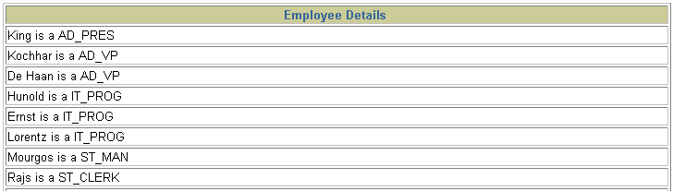
Using Literal Character Strings
SELECT last_name ||' is a '||job_id
AS "Employee Details"
FROM employees;
…
Notes:
Literal Character Strings (continued)
The example in the slide displays last names and job codes of all employees. The column has the heading Employee Details. Notice the spaces between the single quotation marks in the SELECT statement. The spaces improve the readability of the output.
In the following example, the last name and salary for each employee are concatenated with a literal to give the returned rows more meaning:
SELECT last_name ||': 1 Month salary = '||salary Monthly
FROM employees;

Slide 23

Alternative Quote (q) Operator
  Specify your own quotation mark delimiter
  Choose any delimiter
  Increase readability and usability
SELECT department_name ||
q'[, it's assigned Manager Id: ]'
|| manager_id
AS "Department and Manager"
FROM departments;
…
Notes:
Alternative Quote (q) Operator
Many SQL statements use character literals in expressions or conditions. If the literal itself contains a single quotation mark, you can use the quote (q) operator and choose your own quotation mark delimiter.
You can choose any convenient delimiter, single-byte or multibyte, or any of the following character pairs: [ ], { }, ( ), or < >.
In the example shown, the string contains a single quotation mark, which is normally interpreted as a delimiter of a character string. By using the q operator, however, the brackets [] are used as the quotation mark delimiter. The string between the brackets delimiters is interpreted as a literal character string.

Slide 24


Duplicate Rows
The default display of queries is all rows, including duplicate rows.
SELECT department_id
FROM employees;
1
…
SELECT DISTINCT department_id
FROM employees;
2
…
Notes:
Duplicate Rows
Unless you indicate otherwise, iSQL*Plus displays the results of a query without eliminating duplicate rows. The first example in the slide displays all the department numbers from the EMPLOYEES table. Notice that the department numbers are repeated.
To eliminate duplicate rows in the result, include the DISTINCT keyword in the SELECT clause immediately after the SELECT keyword. In the second example in the slide, the EMPLOYEES table actually contains 20 rows, but there are only seven unique department numbers in the table.
You can specify multiple columns after the DISTINCT qualifier. The DISTINCT qualifier affects all the selected columns, and the result is every distinct combination of the columns.
SELECT DISTINCT department_id, job_id
FROM employees;

Slide 25



SQL and iSQL*Plus Interaction
SQL statements
Internet
browser
Oracle
server
iSQL*Plus
commands
Query results
Formatted report
Client
Notes:
SQL and iSQL*Plus
SQL is a command language for communication with the Oracle server from any tool or application. Oracle SQL contains many extensions.
iSQL*Plus is an Oracle tool that recognizes and submits SQL statements to the Oracle server for execution and contains its own command language.
Features of SQL
Can be used by a range of users, including those with little or no programming experience
Is a nonprocedural language
Is an English-like language
Features of iSQL*Plus
Is accessed from a browser
Accepts SQL statements
Provides online editing for modifying SQL statements
Controls environmental settings
Formats query results into a basic report
Accesses local and remote databases

Slide 26
SQL Statements Versus
SQL*Plus Commands
SQL
  A language
  ANSI standard
  Keyword cannot be abbreviated
  Statements manipulate data and table definitions in the database
SQL*Plus
  An environment
  Oracle-proprietary
  Keywords can be abbreviated
  Commands do not allow manipulation of values in the database
  Runs on a browser
  Centrally loaded; does not have to be implemented on each machine
SQL
statements
SQL*Plus
commands
Notes:
SQL and iSQL*Plus (continued)
The following table compares SQL and iSQL*Plus:

Slide 27
SQL Statements Versus iSQL*Plus Commands
SQL
  A language
  ANSI standard
  Keyword cannot be abbreviated
  Statements manipulate data and table definitions in the database
iSQL*Plus
  An environment
  Oracle-proprietary
  Keywords can be abbreviated
  Commands do not allow manipulation of values in the database
  Runs on a browser
  Centrally loaded; does not have to be implemented on each machine
SQL
statements
iSQL*Plus
commands
Notes:
SQL and iSQL*Plus (continued)
The following table compares SQL and iSQL*Plus:

Slide 28
Overview of SQL*Plus
After you log in to SQL*Plus, you can:
  Describe table structures
  Enter, execute, and edit SQL statements
  Save or append SQL statements to files
  Execute or edit statements that are stored in saved script files
Notes:
iSQL*Plus
iSQL*Plus is an environment in which you can do the following:
Execute SQL statements to retrieve, modify, add, and remove data from the database
Format, perform calculations on, store, and print query results in the form of reports
Create script files to store SQL statements for repeated use in the future
iSQL*Plus commands can be divided into the following main categories:

Slide 29
Overview of iSQL*Plus
After you log in to iSQL*Plus, you can:
  Describe table structures
  Enter, execute, and edit SQL statements
  Save or append SQL statements to files
  Execute or edit statements that are stored in saved script files
Notes:
iSQL*Plus
iSQL*Plus is an environment in which you can do the following:
Execute SQL statements to retrieve, modify, add, and remove data from the database
Format, perform calculations on, store, and print query results in the form of reports
Create script files to store SQL statements for repeated use in the future
iSQL*Plus commands can be divided into the following main categories:

Slide 30
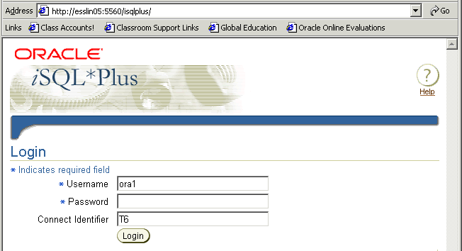
Logging In to iSQL*Plus
  From your browser environment:
Notes:
Logging In to iSQL*Plus
To log in from a browser environment:
1. Start the browser.
2. Enter the URL address of the iSQL*Plus environment.
3. On the Login page, enter appropriate values in the Username, Password, and Connect Identifier fields.

Slide 31
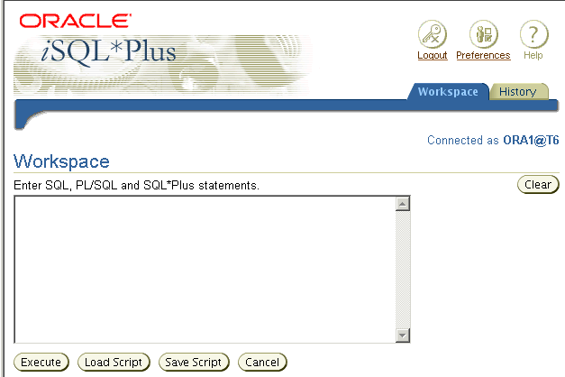
iSQL*Plus Environment
8
9
7
1
6
2
3
4
5
Notes:
iSQL*Plus Environment
In the browser, the iSQL*Plus Workspace page has several key areas:
1. Text box: Area where you type the SQL statements and iSQL*Plus commands
2. Execute button: Click to execute the statements and commands in the text box
3. Load Script button: Brings up a form where you can identify a path and file name or a URL that contains SQL, PL/SQL, or SQL*Plus commands and load them into the text box
4. Save Script button: Saves the contents of the text box to a file
5. Cancel button: Stops the execution of the command in the text box
6. Clear Screen button: Click to clear text from the text box
7. Logout icon: Click to end the iSQL*Plus session and return to the iSQL*Plus Login page
8. Preferences icon: Click to change your interface configuration, system configuration, or password
9. Help icon: Provides access to iSQL*Plus help documentation

Slide 32
Displaying Table Structure
Use the SQL*Plus DESCRIBE command to display the structure of a table:
DESC[RIBE] tablename
Notes:
Displaying the Table Structure
In iSQL*Plus, you can display the structure of a table by using the DESCRIBE command. The command displays the column names and data types, and it shows you whether a column must contain data (that is, whether the column has a NOT NULL constraint).
In the syntax, tablename is the name of any existing table, view, or synonym that is accessible to the user.

Slide 33
Displaying Table Structure
Use the iSQL*Plus DESCRIBE command to display the structure of a table:
DESC[RIBE] tablename
Notes:
Displaying the Table Structure
In iSQL*Plus, you can display the structure of a table by using the DESCRIBE command. The command displays the column names and data types, and it shows you whether a column must contain data (that is, whether the column has a NOT NULL constraint).
In the syntax, tablename is the name of any existing table, view, or synonym that is accessible to the user.

Slide 34
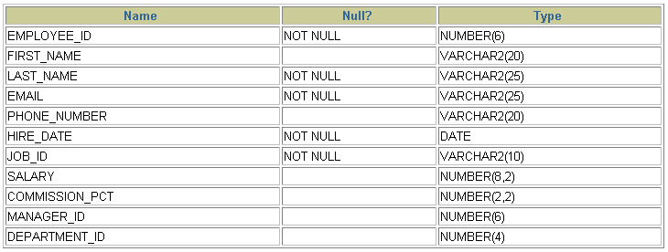
Displaying Table Structure
DESCRIBE employees
Notes:
Displaying the Table Structure (continued)
The example in the slide displays the information about the structure of the EMPLOYEES table.
In the resulting display, Null? indicates that the values for this column may be unknown. NOT NULL indicates that a column must contain data. Type displays the data type for a column.
The data types are described in the following table:

Slide 35
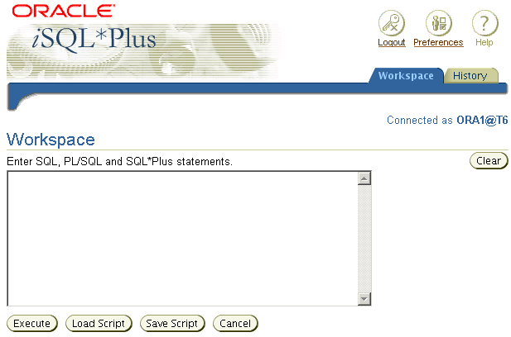
Interacting with Script Files
SELECT last_name, hire_date, salary
FROM employees;
1
2
Notes:
Interacting with Script Files
Placing Statements and Commands into a Text Script File
You can save commands and statements from the text box in iSQL*Plus to a text script file as follows:
1. Type the SQL statements in the text box in iSQL*Plus.
2. Click the Save Script button. This opens the Windows File Save dialog box. Identify the name of the file. The extension defaults to .uix. You can change the file type to a text file or save it as a .sql file.

Slide 36
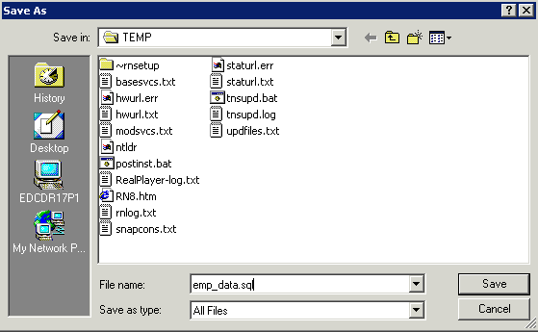
Interacting with Script Files
Notes:
Interacting with Script Files (continued)
In the example shown, the SQL SELECT statement typed in the text box is saved to a file named emp_data.sql. You can choose the type of the file, name of the file, and location of where you want to save the script file.

Slide 37
Interacting with Script Files
1
Notes:
Interacting with Script Files (continued)
Using Statements and Commands from a Script File in iSQL*Plus
You can use previously saved commands and statements from a script file in iSQL*Plus as follows:
1. Click the Load Script button. This opens a form where you can type the name of the file or a URL containing the SQL, PL/SQL, or SQL*Plus commands that you want to enter in the text box.

Slide 38
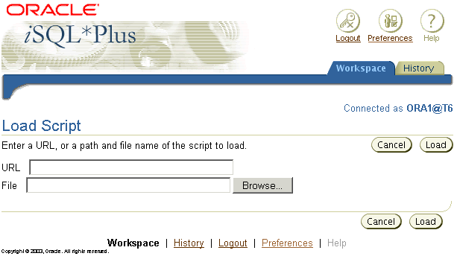
Interacting with Script Files
D:\TEMP\emp_data.sql
2
3
Notes:
Interacting with Script Files (continued)
2. Enter the script name and path, or the URL location. Or you can click the Browse button to find the script name and location.
3. Click the Load button to bring the contents of the file or URL location into the text box.

Slide 39
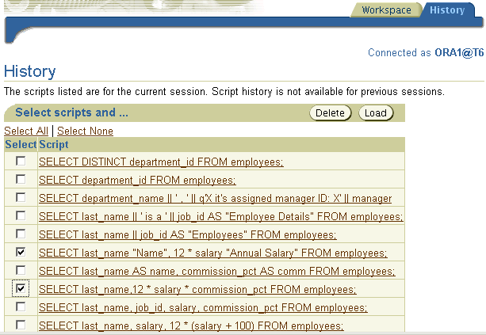
iSQL*Plus History Page
3
2
1
Notes:
Running Previous Statements
The History page in iSQL*Plus lets you execute previously run statements in your session. The History page shows your most recently run SQL statements and iSQL*Plus commands. To rerun the statements:
1. Select the statement that you want to execute.
2. Click the Load button.
Note
You can control the number of statements that are shown on the History page with Preferences settings.
You can choose to delete selected statements by clicking the Delete button.

Slide 40
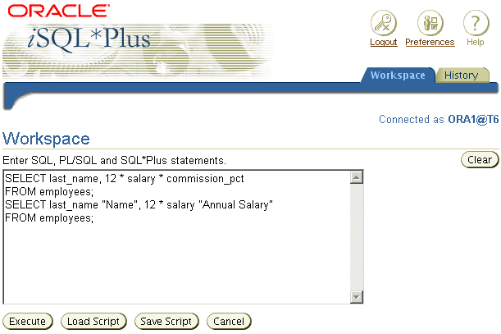
iSQL*Plus History Page
3
4
Notes:
Running Previous Statements (continued)
3. Return to the Workspace page.
4. Click the Execute button to run the commands that have been loaded into the text box.

Slide 41
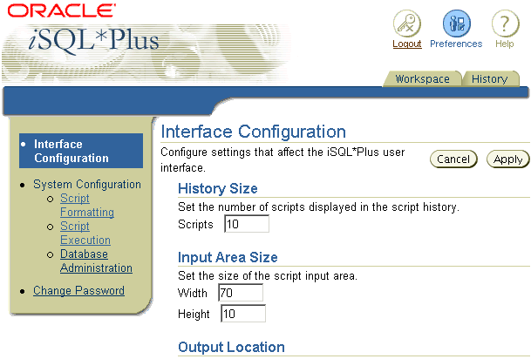
Setting iSQL*Plus Preferences
1
2
3
Notes:
iSQL*Plus Preferences
You can set preferences for your iSQL*Plus session by clicking the Preferences icon.
The preferences are divided into categories. You can set preferences for script formatting, script execution, and database administration, and you can change your password.
When you choose a preference category, a form is displayed that lets you set the preferences for that category.

Slide 42
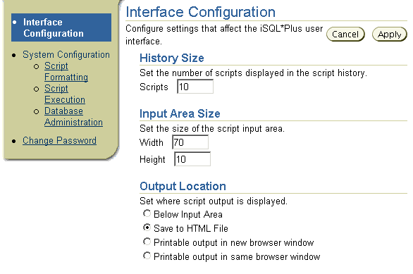
Setting the Output Location Preference
2
1
Notes:
Changing the Output Location
You can send the results that are generated by a SQL statement or iSQL*Plus command to the screen (the default), a file, or another browser window.
On the Preferences page:
1. Select an Output Location option.
2. Click the Apply button.

Slide 43
Summary
In this lesson, you should have learned how to:
  Write a SELECT statement that:
    Returns all rows and columns from a table
    Returns specified columns from a table
    Uses column aliases to display more descriptive column headings
  Use the SQL*Plus environment to write, save, and execute SQL statements and SQL*Plus commands
SELECT *|{[DISTINCT] column|expression [alias],...}
FROM table;
Notes:
SELECT Statement
In this lesson, you should have learned how to retrieve data from a database table with the SELECT statement.
SELECT *|{[DISTINCT] column [alias],...}
FROM table;
In the syntax:
SELECT is a list of one or more columns
* selects all columns
DISTINCT suppresses duplicates
column|expression selects the named column or the expression
alias gives selected columns different headings
FROM table specifies the table containing the columns
iSQL*Plus
iSQL*Plus is an execution environment that you can use to send SQL statements to the database server and to edit and save SQL statements. Statements can be executed from the SQL prompt or from a script file.

Slide 44
Summary
In this lesson, you should have learned how to:
  Write a SELECT statement that:
    Returns all rows and columns from a table
    Returns specified columns from a table
    Uses column aliases to display more descriptive column headings
  Use the iSQL*Plus environment to write, save, and execute SQL statements and iSQL*Plus commands
SELECT *|{[DISTINCT] column|expression [alias],...}
FROM table;
Notes:
SELECT Statement
In this lesson, you should have learned how to retrieve data from a database table with the SELECT statement.
SELECT *|{[DISTINCT] column [alias],...}
FROM table;
In the syntax:
SELECT is a list of one or more columns
* selects all columns
DISTINCT suppresses duplicates
column|expression selects the named column or the expression
alias gives selected columns different headings
FROM table specifies the table containing the columns
iSQL*Plus
iSQL*Plus is an execution environment that you can use to send SQL statements to the database server and to edit and save SQL statements. Statements can be executed from the SQL prompt or from a script file.

Slide 45
Practice 1: Overview
This practice covers the following topics:
  Selecting all data from different tables
  Describing the structure of tables
  Performing arithmetic calculations and specifying column names
  Using iSQL*Plus
Notes:
Practice 1: Overview
This is the first of many practices in this course. The solutions (if you require them) can be found in Appendix A. Practices are intended to cover all topics that are presented in the corresponding lesson.
Note the following location for the lab files:
E:\labs\SQL1\labs
If you are asked to save any lab files, save them at this location.
To start ISQL*Plus, start your browser. You need to enter a URL to access iSQL*Plus. The URL requires the host name, which your instructor will provide. Enter the following command, replacing the host name with the value that your instructor provides: http://<HOSTNAME:5561>/isqlplus
In any practice, there may be exercises that are prefaced with the phrases “If you have time” or “If you want an extra challenge.” Work on these exercises only if you have completed all other exercises in the allocated time and would like a further challenge to your skills.
Perform the practices slowly and precisely. You can experiment with saving and running command files. If you have any questions at any time, ask your instructor.

